Slide 1
深度學習分析
吳明軒、徐仁瓏、曾文海、李家銘

Slide 2
What is Deep Learning?

Slide 3

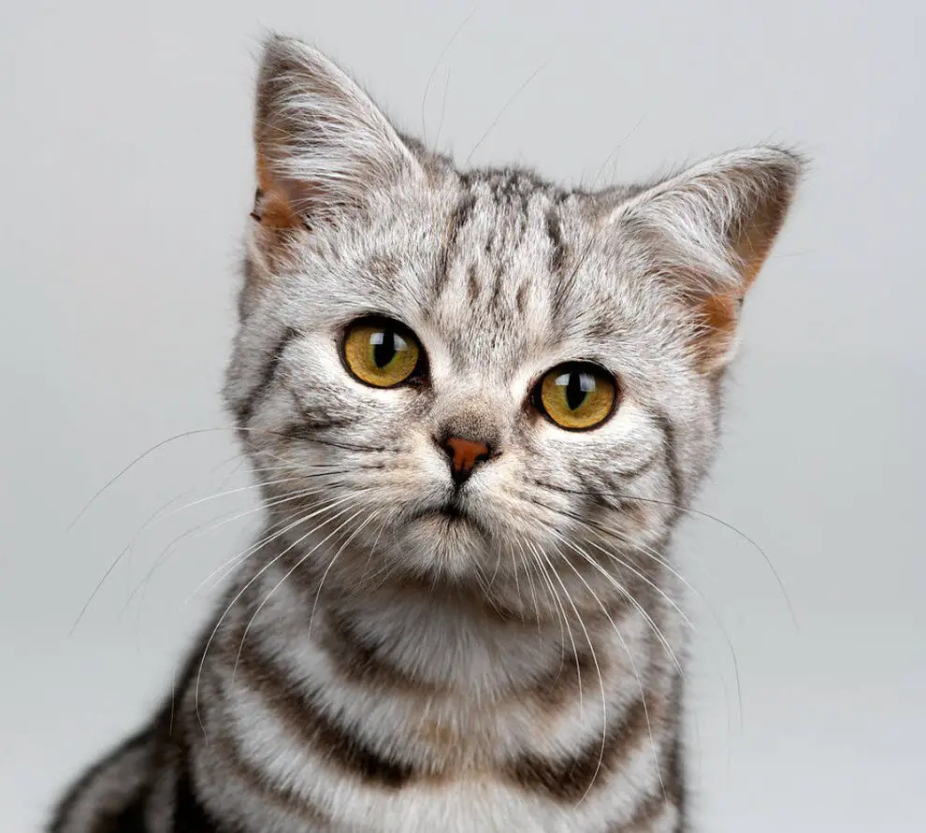
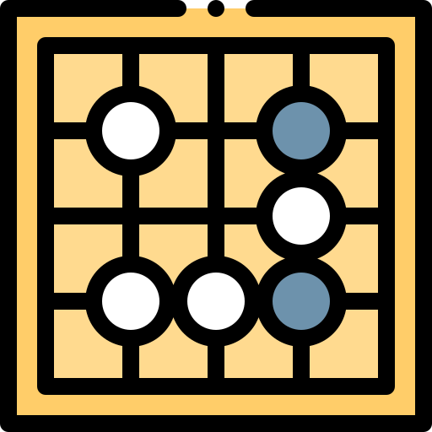
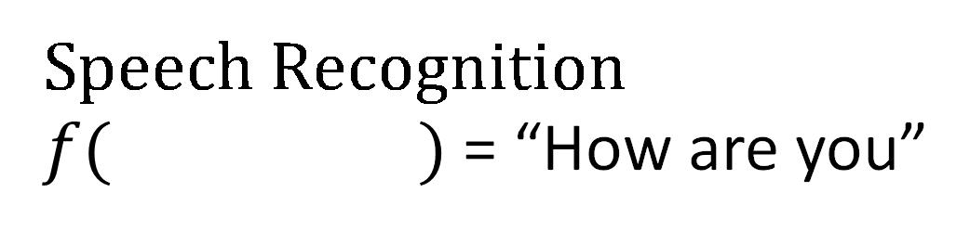
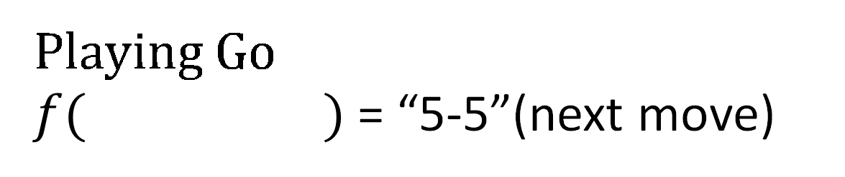
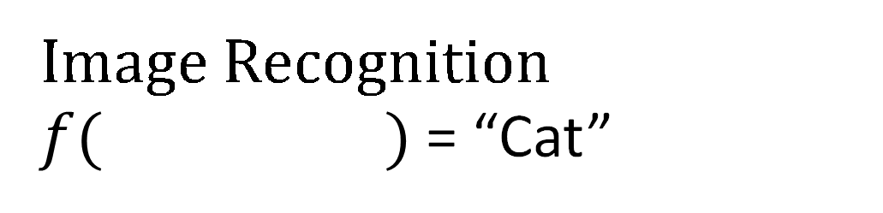
Learning ≈ Looking for a Function
Speech Recognition
$f( )$ = “How are you”
Image Recognition
$f( )$ = “Cat”
Playing Go
$f( )$ = “5-5”(next move)

Slide 4
Learning ≈ Looking for a Function
Neural Network
Input X
Output Y

Slide 5
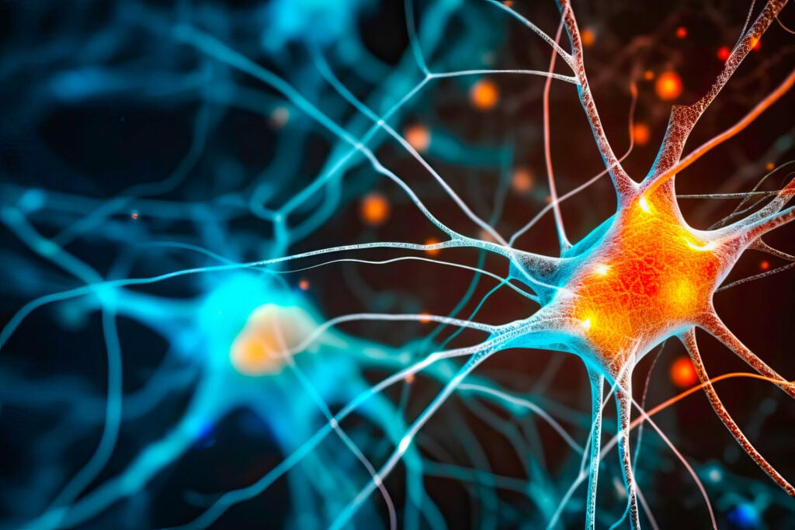

Why Deep?

Slide 6
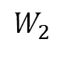
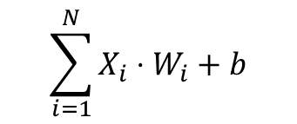
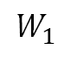
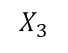
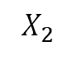
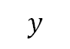
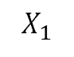
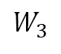
Why Deep?
$$W_{1}$$
$$X_{1}$$
$$\sum_{i=1}^{N}{X_{i}}⋅W_{i}+b$$
$$W_{2}$$
Activation Function
$$X_{2}$$
$$y$$
$$W_{3}$$
$$X_{3}$$
Neuron/Perceptron
Neural Network

Slide 7
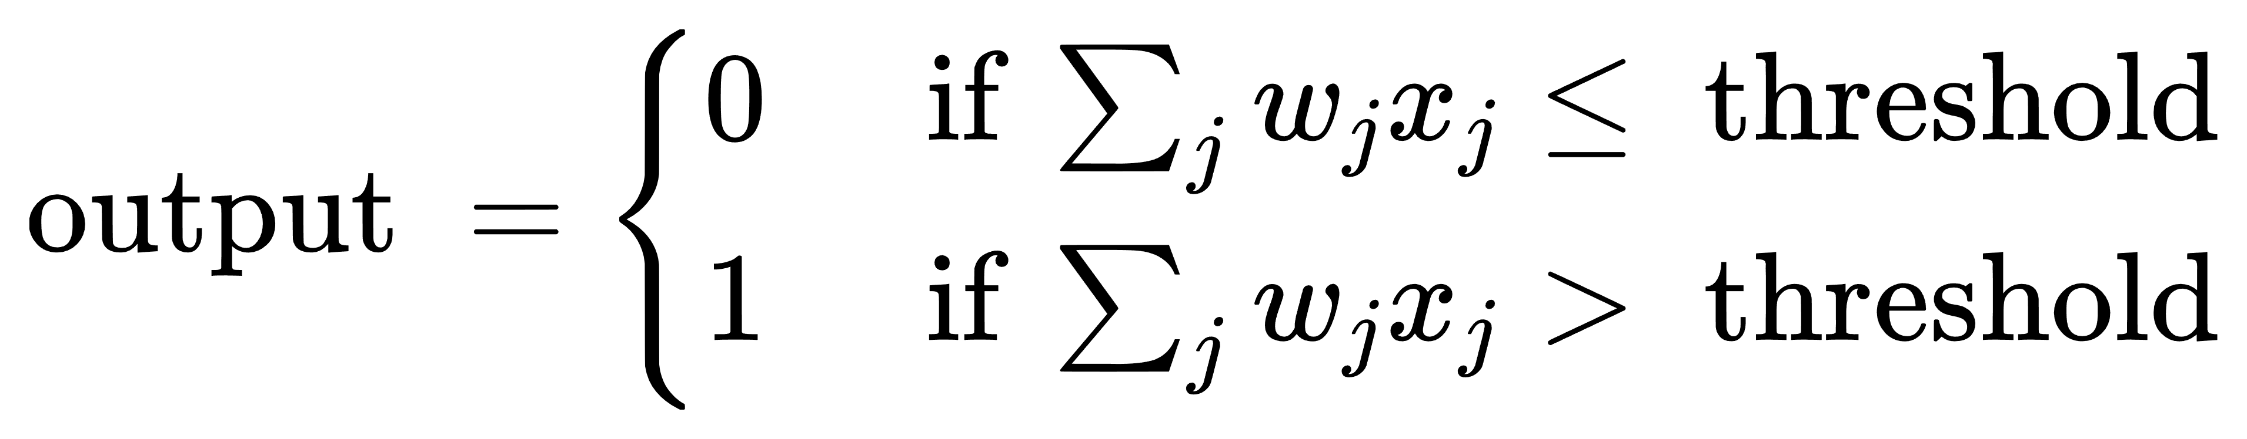
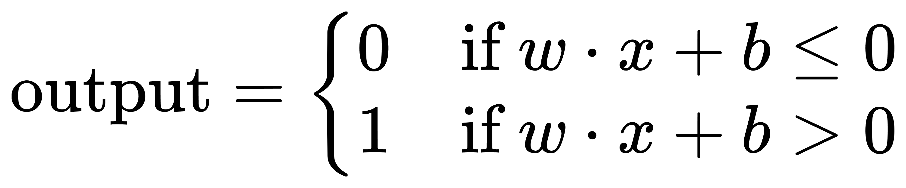
Activation Function
Non-linearity Introduction
Thresholding
Gradient Computation
Regularization Effect

Slide 8
When to use DL?
Data Type | Recommended Neural Network Types | Example Applications
Tabular Data | Feedforward Neural Network (FNN) / Multilayer Perceptron (MLP) | Regression、Classification
Images | Convolutional Neural Network (CNN) | Image recognition Object detection
Audio | Recurrent Neural Network (RNN) Long Short-Term Memory (LSTM) | Speech generation Music generation
Text | RNN、LSTM Transformer | Text generation Sentiment analysis
Video | 3D Convolutional Neural Network (3D-CNN) Recurrent Neural Network (RNN) | Video categorization Real-time video analysis
Graph Data | Graph Neural Network (GNN) | Social network analysis Recommendation systems
Any Type | Generative Adversarial Network (GAN) | Artistic creation Data augmentation
Papers With Code

Slide 9
How to Deep Learning?

Slide 10
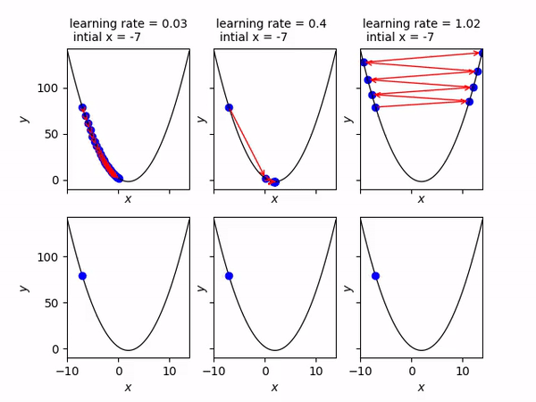
Gradient-Descent

Slide 11
Forward Propagation
Backward Propagation

Slide 12

Convolutional Neural Network (CNN)?

Slide 13
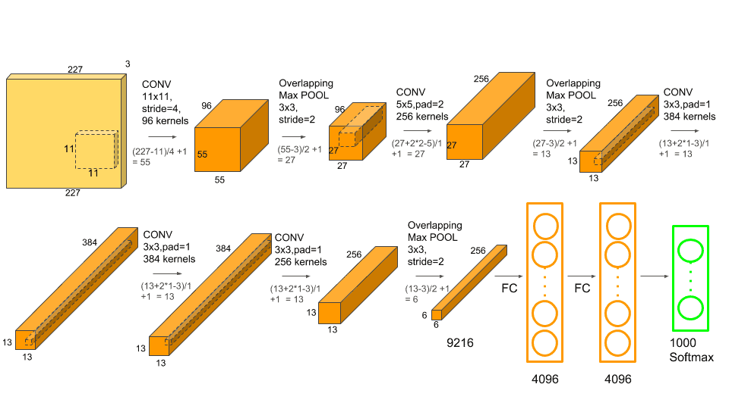
AlexNet (2012)
Input Layer
Hidden Layer
Output Layer
Understanding AlexNet

Slide 14

Convolutional Layer
Main work:
Feature Extraction
Local Connectivity
Weight Sharing
Parameter:
in_channels
out_channels
kernel_size
stride=1
padding=0
Conv_visualization
Notes:
特徵提取： 利用不同的卷積核（濾波器）自動學習和提取數據中的局部特徵，例如邊緣、紋理和形狀。
局部連接： 只與局部區域相連以捕捉空間關係，降低計算複雜度。
共享權重： 同一卷積核在整個輸入上共享，使模型能夠學習全局特徵，同時減少所需的參數數量。

Slide 15
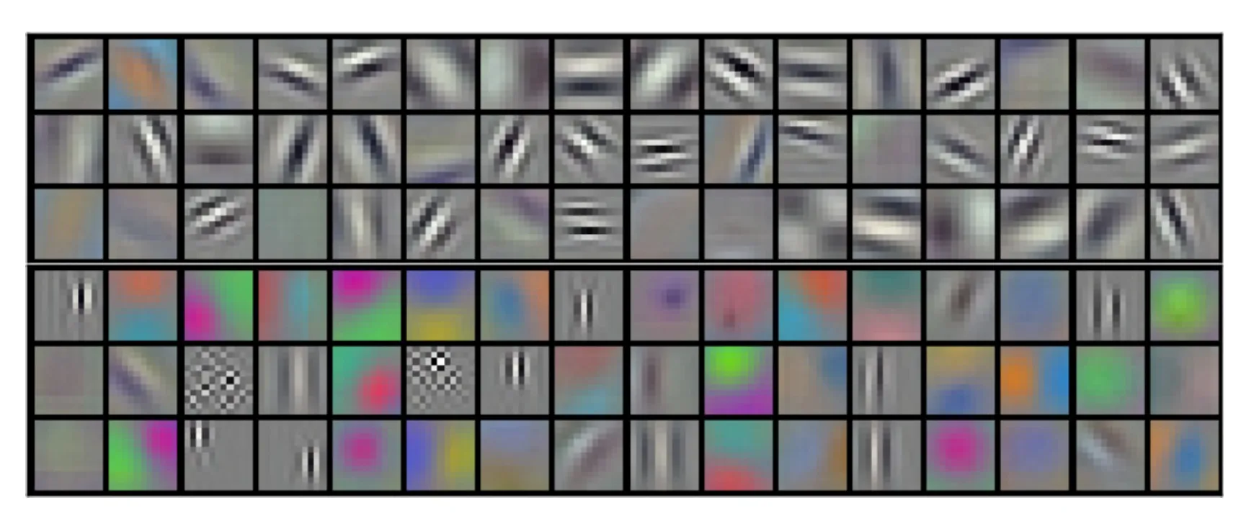
Kernel

Slide 16
AlexNet (2012)
Input Layer
Hidden Layer
Output Layer
Understanding AlexNet

Slide 17
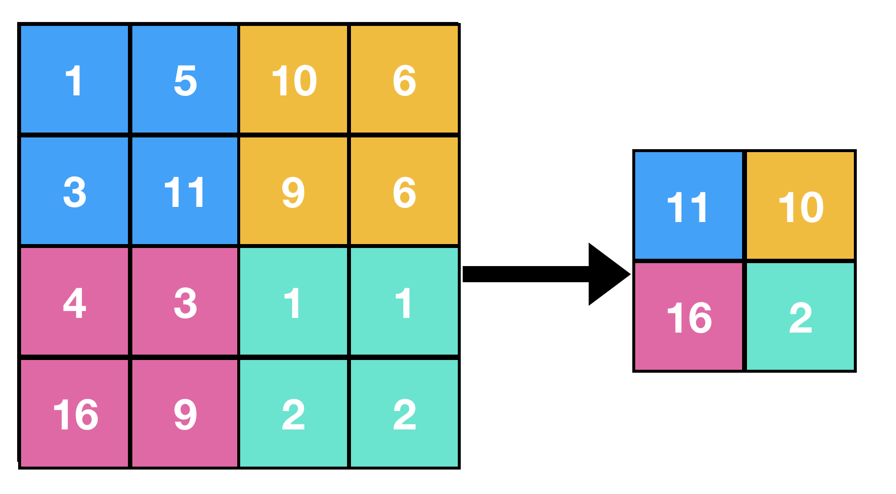
Max Pooling Layer
Main work:
Dimensionality Reduction
Feature Invariance
Noise Suppression
Parameter:
kernel_size
stride=None
padding=0
Notes:
降維： 減少特徵圖的尺寸，降低後續層的計算負擔，並且通過特徵抽象減少過擬合的可能性。
特徵不變性： 幫助特徵檢測在尺度和方位變化上具有不變性，通過在池化區域內提取最大值來實現這一點。
噪音抑制： 透過在每個區域內提取最大值，最大池化層可以抑制噪音和無關的細節。

Slide 18
AlexNet (2012)
Input Layer
Hidden Layer
Output Layer
Understanding AlexNet

Slide 19
Flatten Layer
Main work:
Dimensionality Reduction
Preparation for Fully Connected Layers
Information Preservation
Parameter:
start_dim=1
end_dim=-1
Notes:
降維： 將多維特徵圖轉換為一維向量。
為全連接層做準備： 使提取的特徵能夠被全連接層處理，全連接層通常需要一維的輸入。
保留信息： 保持從前面卷積和池化層中學到的重要特徵。

Slide 20
AlexNet (2012)
Input Layer
Hidden Layer
Output Layer
Understanding AlexNet

Slide 21
Fully Connected Layer
Main work:
Feature Integration
Classification or Regression
Parameter:
in_features
out_features
Notes:
特徵融合： 將前面層提取的所有特徵整合起來，形成更加完整的特徵表示。
分類或回歸： 通過將提取的特徵映射到輸出空間，用於最終的分類或回歸任務。

Slide 22
Dropout
Main work:
Preventing Overfitting
Improving Generalization
Parameter:
p=0.5
Notes:
防止過擬合： 通過訓練期間隨機禁用部分神經元，減少網絡對特定特徵的依賴。
提高泛化能力： 鼓勵網絡學習更通用的特徵，提高其在未見過的數據上的性能。

Slide 23
AlexNet (2012)
Input Layer
Hidden Layer
Output Layer
Understanding AlexNet

Slide 24
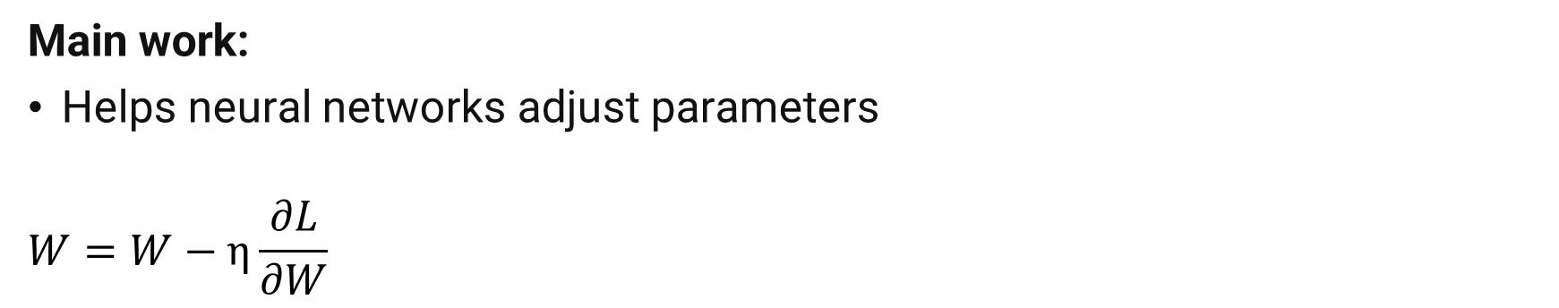
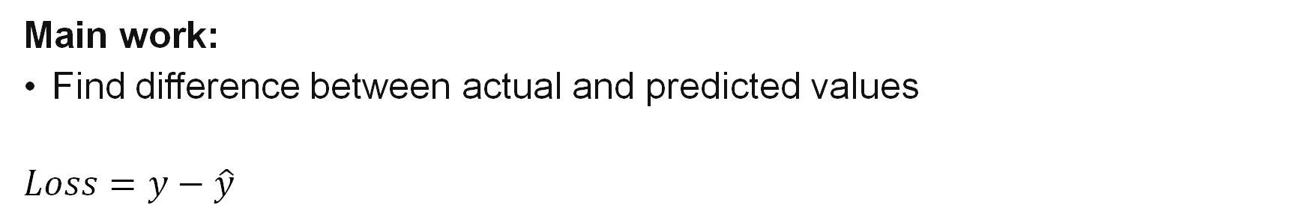
Loss Function
Main work:
Find difference between actual and predicted values
$$Loss=y−\hat{y}$$
Optimizer
Main work:
Helps neural networks adjust parameters
$$W=W−η\frac{∂L}{∂W}$$

Slide 25
Summary
Component | Main Work
Convolutional Layer | Feature Extraction
Max Pooling Layer | Noise Suppression
Flatten Layer | Preparation for Fully Connected Layers
Fully Connected Layer | Feature Integration and Get Result.
Dropout | Preventing Overfitting
Loss Function | Find difference between actual and predicted values
Optimizer | Helps neural networks adjust parameters
Papers With Code

Slide 26
Image Classification Example
Hyperparameters
Dataset
DataLoader
Model
Evaluation
【PyTorch教程】

Slide 28
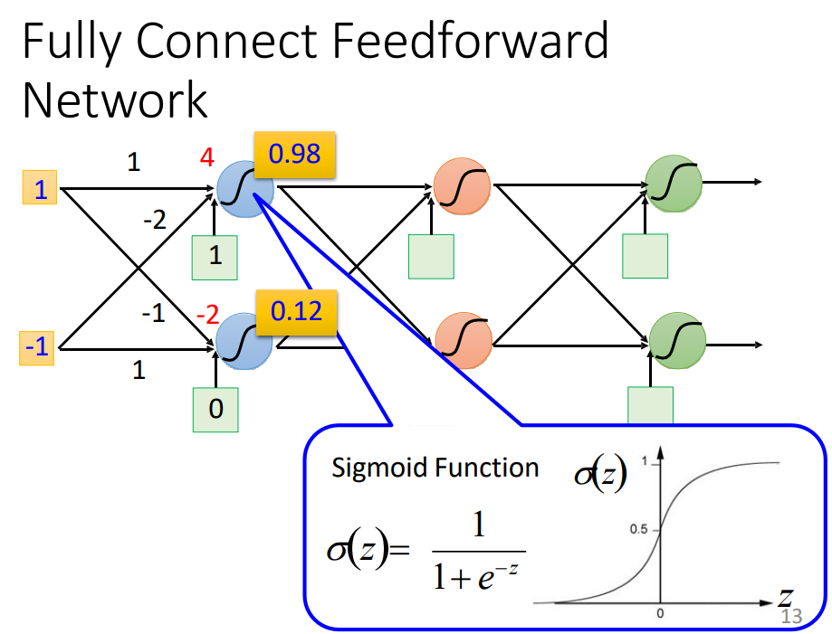
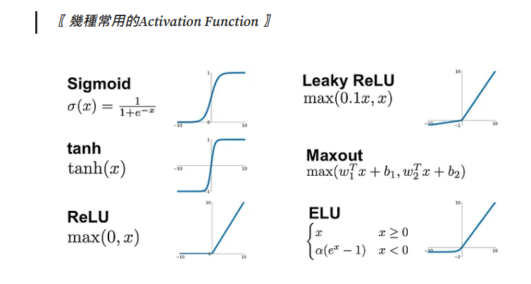
神經元-激活函數

Slide 29
Tips for Deep Learning?

Slide 30

Tips for Deep Learning
Yes
Choosing Proper loss
Good Results on Testing Data?
Early Stopping
Mini-batch
Weight decay
New activation function
Yes
Dropout
Good Results on Training Data?
Learning Rate
Network
Momentum

Slide 31
Underfitting
Yes
Choosing Proper loss
Good Results on Testing Data?
Mini-batch
New activation function
Yes
Good Results on Training Data?
Learning Rate
Momentum

Slide 32
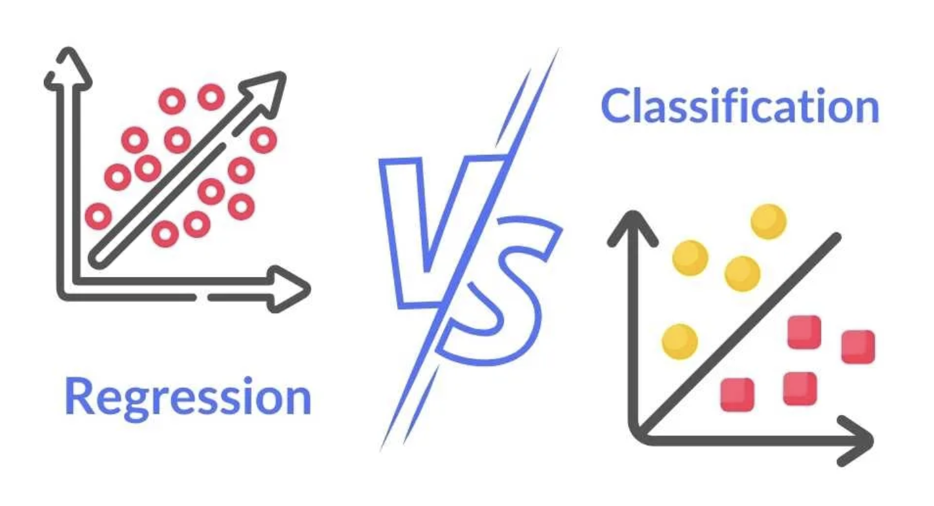
Loss Function
Regression
MAE
MSE
Huber Loss
​
Classification
0-1 loss​
Cross Entropy

Slide 33
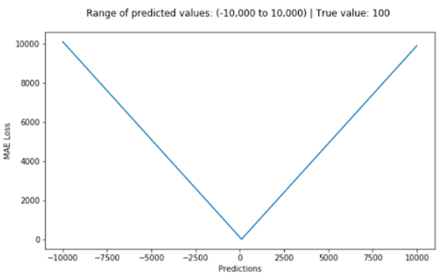
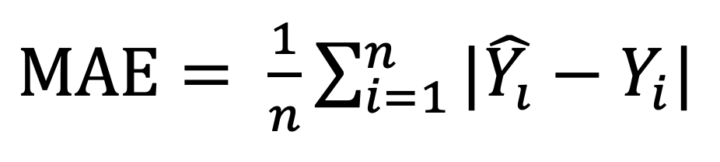
Loss Function for Regression
Mean Absolute Error / L1 Loss

Slide 34
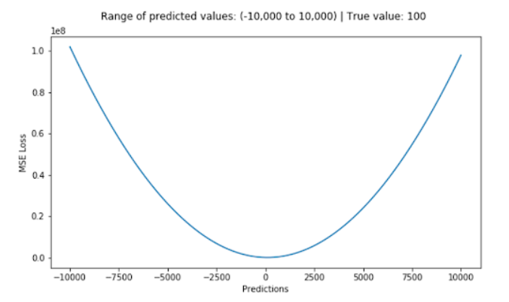
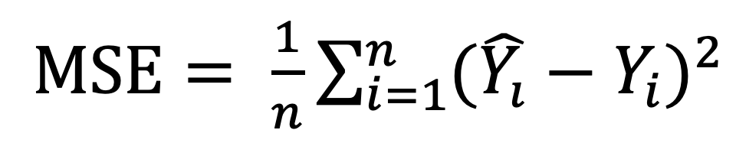
Loss Function for Regression
Mean Square Error / Quadratic Loss / L2 Loss

Slide 35
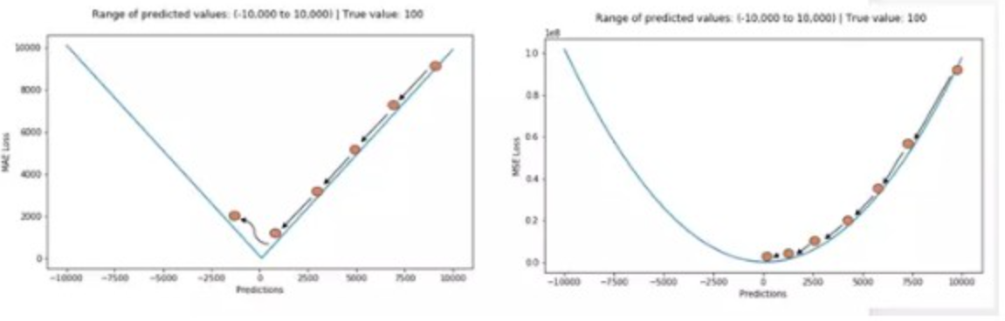
Loss Function for Regression
MAE
MSE

Slide 36
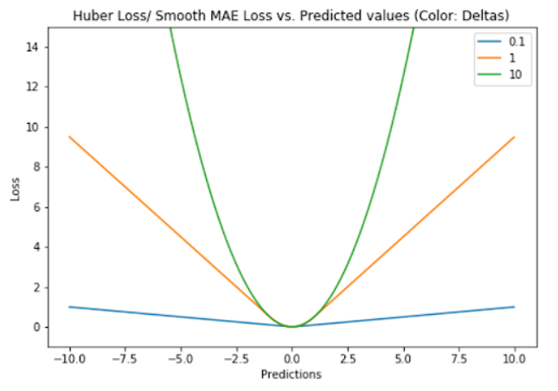
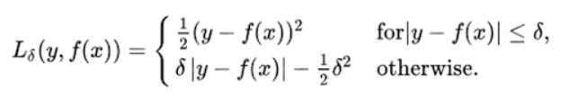
Loss Function for Regression
Huber Loss / Smooth Mean Absolute Error

Slide 37
Loss Function for Regression
MSE vs. MAE:
Choose MSE when outliers are crucial to the business and need to be fitted as closely as possible. If outliers are just noise data, then MAE loss should be used.
When to choose Huber Loss:
In cases where neither MSE nor MAE can fit the data well, Huber Loss is a suitable choice. MAE loss exhibits large gradients near extreme values, making it unstable and insensitive to outliers, while MSE is sensitive to outliers but gradually diminishes gradients near extreme values, allowing for precise estimations. Huber Loss combines aspects of both by treating outliers akin to MAE and extreme values akin to MSE.

Slide 38
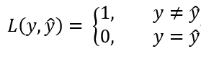
Loss Function for Classification
0-1 Loss

Slide 39
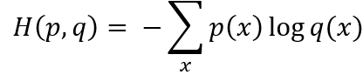
Loss Function for Classification
Cross-Entropy Loss

Slide 40
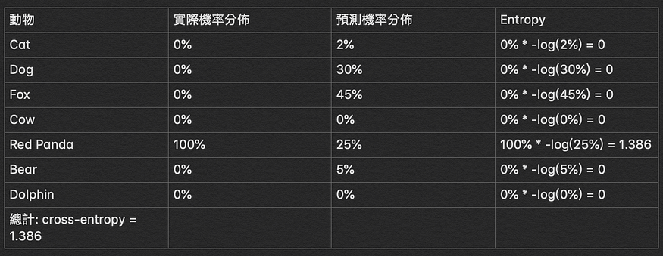
Loss Function for Classification
Cross-Entropy Loss

Slide 41
Loss Function for Classification
Loss Function | Model | note
0-1 Loss | Perceptron | It is a non-convex function and not very suitable.
Cross-Entropy Loss | Logistic Regression | The most common loss function.

Slide 42
Underfitting
Yes
Choosing Proper loss
Good Results on Testing Data?
Mini-batch
New activation function
Yes
Good Results on Training Data?
Learning Rate
Momentum

Slide 43
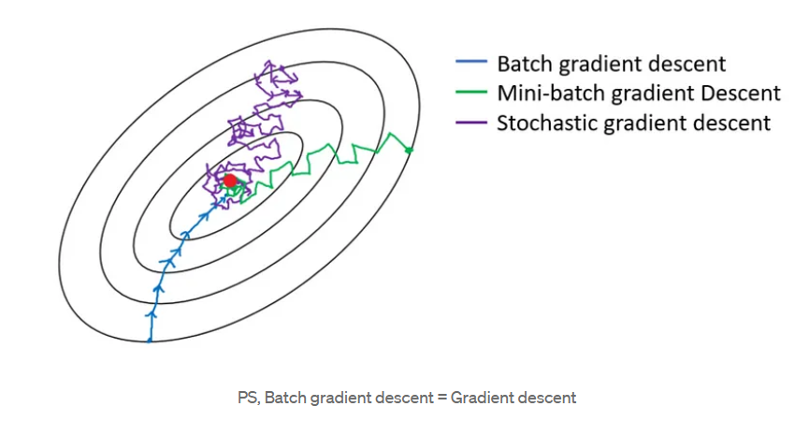
Mini-batch
Batch gradient descent
Mini-batch gradient descent
Stochastic gradient descent

Slide 44
Characteristics | Batch Gradient Descent | Mini-batch Gradient Descent | Stochastic Gradient Descent
Update Frequency | Once per training cycle | Once per mini-batch | Once per sample
Convergence Speed | Slow | Faster | Faster
Memory Requirements | Requires storing all training data | Requires less memory | Requires the least memory
Robustness to Noise | Strongest | Stronger | Weakest
Stability | High | Moderate | Low
Likelihood of Converging to Global Optimum | Higher | Higher | Lower
Efficiency with Batch Processing | Lowest | Moderate | Highest

Slide 45
Underfitting
Yes
Choosing Proper loss
Good Results on Testing Data?
Mini-batch
New activation function
Yes
Good Results on Training Data?
Learning Rate
Momentum

Slide 46
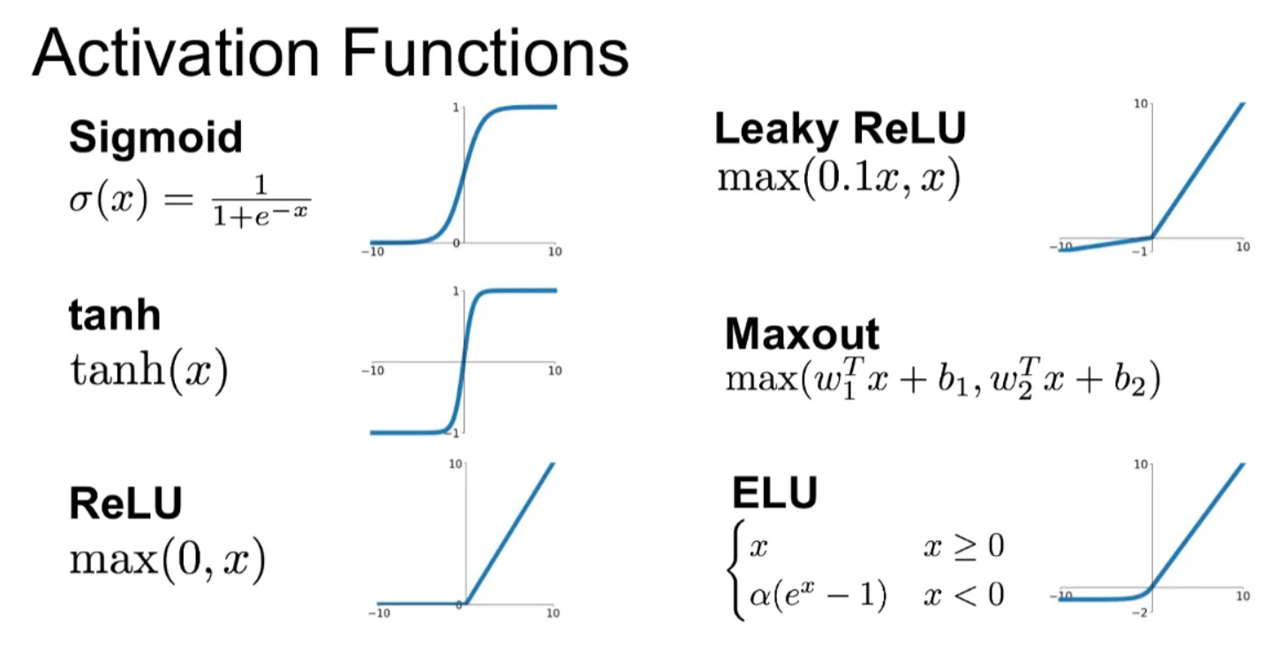
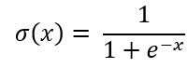
Activation function
Sigmoid
Range from [0,1]
Not Zero Centered
Computationally Expensive
Vanishing Fradient Problem

Slide 47
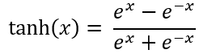
Activation function
Tanh （hyperbolic tangent activation function）
Range from [-1,1]
Zero Centered
Computationally Expensive
Vanishing Fradient Problem

Slide 48
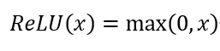
Activation function
ReLU（Rectified Linear Unit）
Converges Faster
Dead ReLU Problem

Slide 49
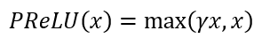
Activation function
Parametric ReLU
Requires tuning the parameter

Slide 50
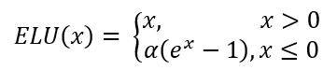
Activation function
ELU（Exponential Linear Unit）
Closer to Zero mean Outputs than Parametric ReLU
More Computation because of Exponential Function

Slide 51
Activation Function | Advantages | Disadvantages | Suitable for
Sigmoid | Output range in (0, 1), suitable for binary classification | May lead to gradient vanishing problem | Binary classification, but may suffer from gradient vanishing in deep networks
Tanh | Output range in (-1, 1), zero-centered, suitable for hidden layers | Still susceptible to gradient vanishing | Hidden layer activation, especially in RNN
ReLU | Fast computation, fast convergence | May lead to "dying ReLU" problem | Widely used in CNN
Parametric ReLU | Addresses the "dying ReLU" problem | Requires tuning of the leaky parameter, slower computation | Used when ReLU encounters "dying ReLU" problem
ELU | Addresses the "dying ReLU" problem, maintains zero-centeredness | Slower computation | Widely used in RNN

Slide 52
Underfitting
Yes
Choosing Proper loss
Good Results on Testing Data?
Mini-batch
New activation function
Yes
Good Results on Training Data?
Learning Rate
Momentum

Slide 53
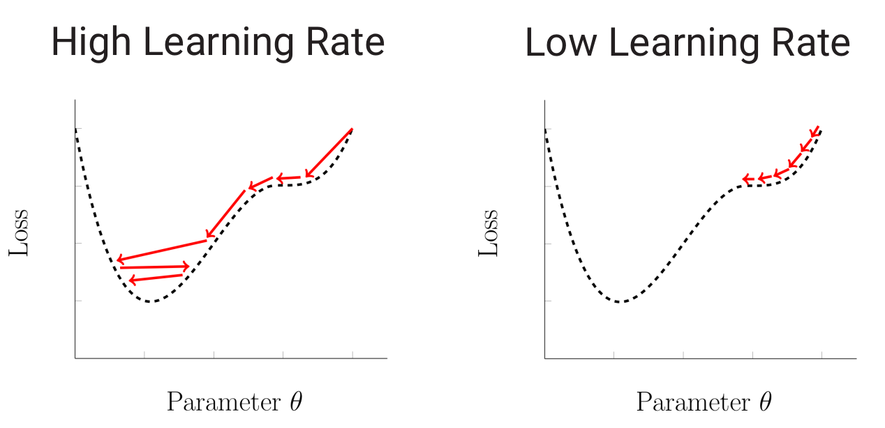
Learning Rate

Slide 54
Learning Rate
Learning Rate Decay
Adaptive Learning Rate

Slide 55
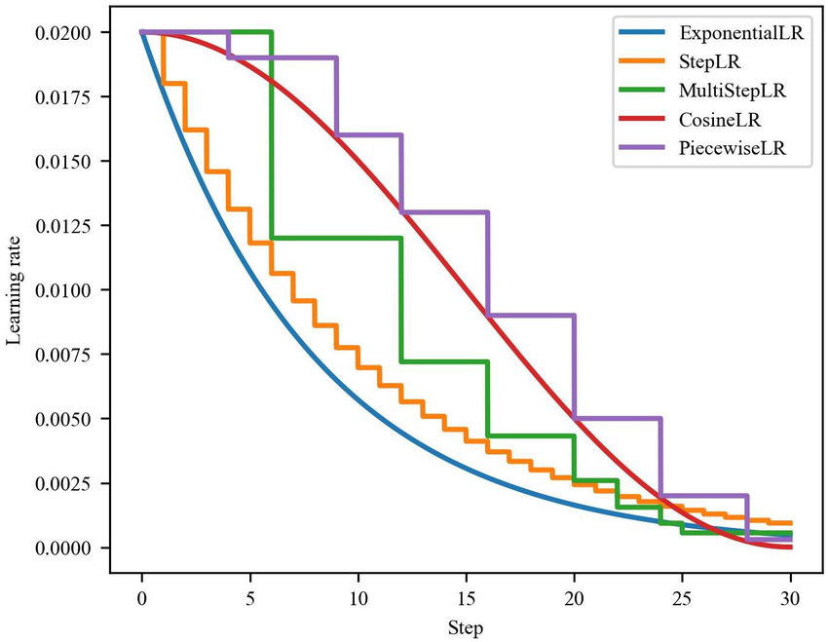
Learning Rate Decay

Slide 56
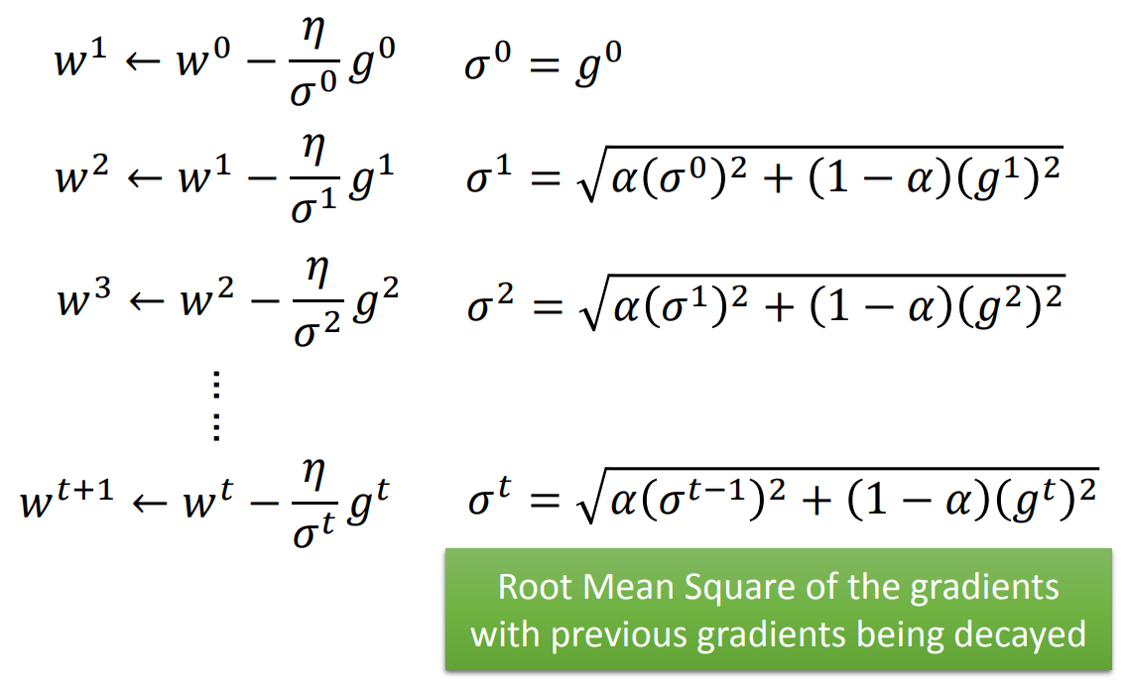
Adaptive Learning Rate
RMSProp

Slide 57
Underfitting
Yes
Choosing Proper loss
Good Results on Testing Data?
Mini-batch
New activation function
Yes
Good Results on Training Data?
Learning Rate
Momentum

Slide 58
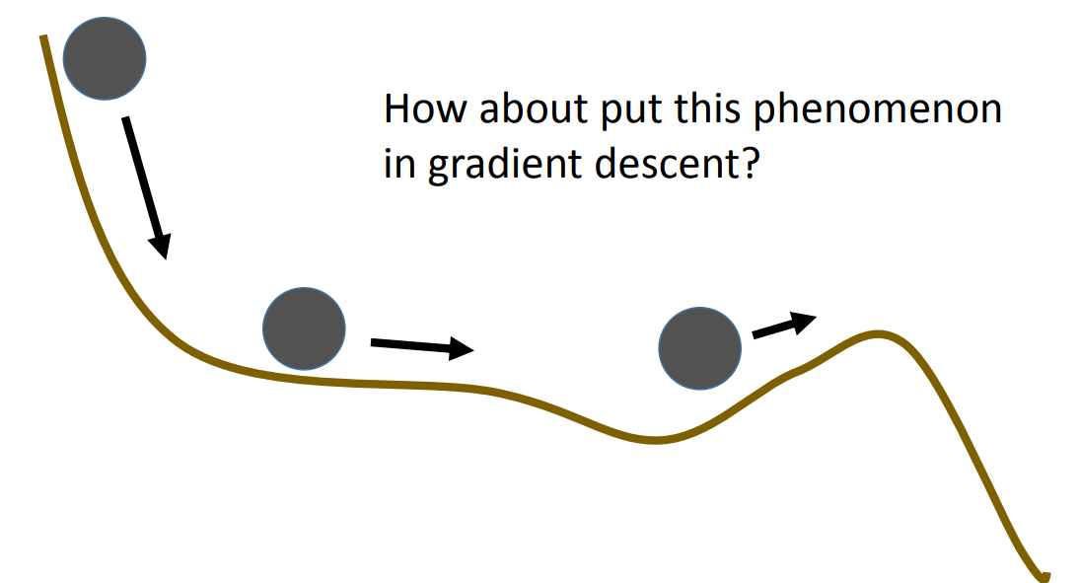
Momentum

Slide 59
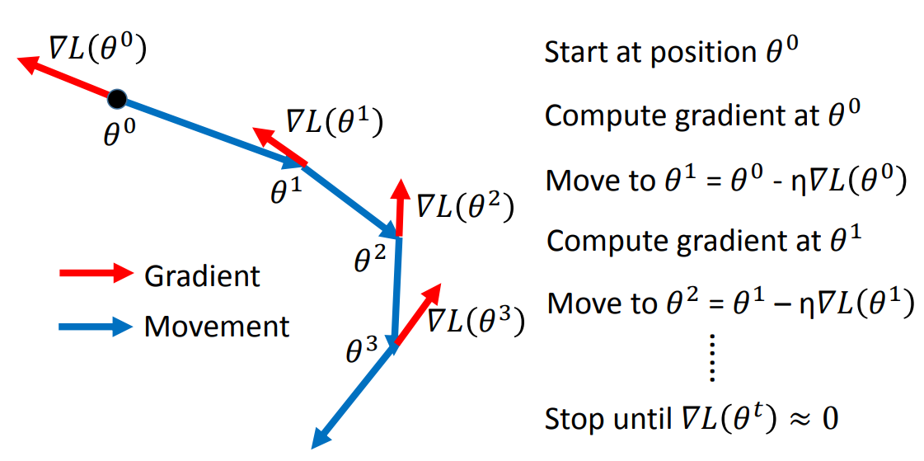
Vanilla Gradient Descent

Slide 60
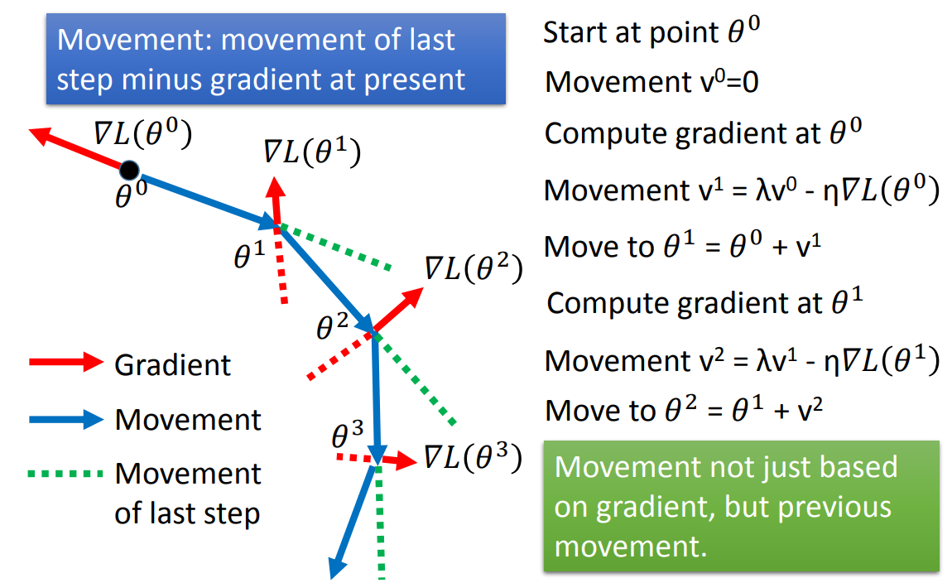
Momentum

Slide 61
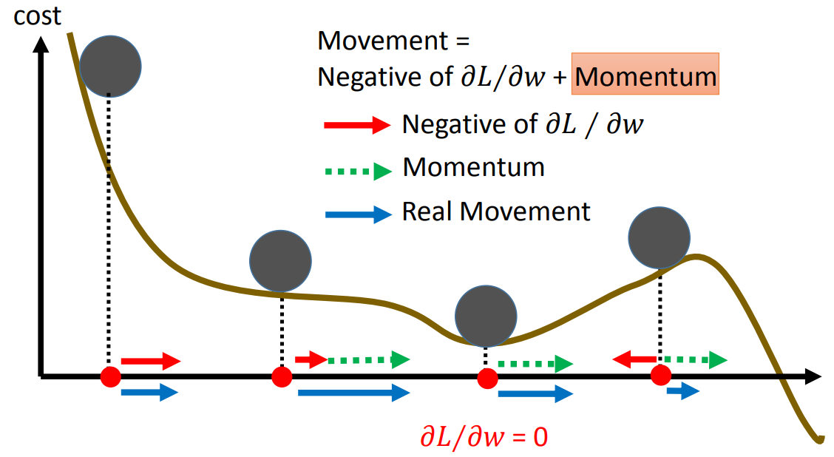
Momentum

Slide 62
Overfitting
Yes
Good Results on Testing Data?
Early Stopping
Weight decay
Yes
Dropout
Good Results on Training Data?
Network

Slide 63
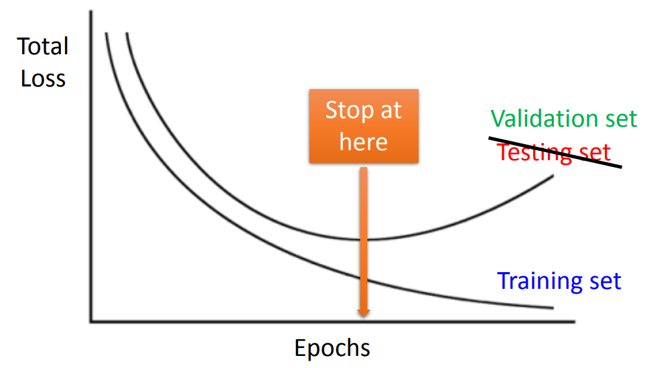
Early Stopping

Slide 64
Overfitting
Yes
Good Results on Testing Data?
Early Stopping
Weight decay
Yes
Dropout
Good Results on Training Data?
Network

Slide 65

Weight Decay

Slide 66


Weight Decay
Original :
Weight Decay:

Slide 67
Overfitting
Yes
Good Results on Testing Data?
Early Stopping
Weight decay
Yes
Dropout
Good Results on Training Data?
Network

Slide 68

Dropout

Slide 69

Dropout

Slide 70

Dropout

Slide 71

Dropout

Slide 72

Dropout

Slide 73
Overfitting
Yes
Good Results on Testing Data?
Early Stopping
Weight Decay
Yes
Dropout
Good Results on Training Data?
Network Structure

Slide 74

Example

Slide 75

Example

Slide 76

Example

Slide 77

Example

Slide 78

Example

Slide 79

Example

Slide 80

Convolutional Neural Networks utilized for object detection
Reporter:曾文海

Slide 81






Applications of Computer Vision and Common Metrics
$$mAP=\frac{\sum_{c=1}^{n}{{AP}_{c}}}{\text{Number} \text{of} \text{Categories}}$$

Slide 82

Search for best models
https://paperswithcode.com/sota/object-detection-on-coco

Slide 83


Object Label

Slide 84


What is one-stage, what is two-stage object detection?
One stage
Two stage
 | One stage | Two stage
Advantage | Fast speed Avoids background errors producing false positives . Learns generalized features of objects. | High accuracy (localization, detection rate). Shared computational load.
Disadvantages | Low accuracy (localization, detection rate). Poor detection performance for small objects. | Slow speed. Long training time. Relatively high false positives.

Slide 85


Sliding windows and Selective search
Sliding windows
Sliding windows method is slow.
Different sizes windows.
Selective search
Find image regions that are possible to contain objects.
https://pyimagesearch.com/wp-content/uploads/2014/10/sliding_window_example.gif

Slide 86


Structural Variations in Object Detection
Features are computed from images with different scales independently (Featured image pyramids)
Single scale features (Faster R-CNN and R-FCN, YOLOv1 and YOLOv2)
Multi-scale features (Pyramidal Feature network, SSD)
Feature fusion method (Feature Pyramid network, YOLOv3)
Multi-scale Fusion (feature fusion and feature pyramid generation method, MDSSD, FSSD)

Slide 87
Model
Two Stage
R-CNN
Fast R-CNN
Faster R-CNN
One Stage
YOLO
Transformer
DETR

Slide 88

R-CNN(2013)
Region proposals(about ~2k) generation using selective search
CNN (VGG) extracts feature from each proposals
Class-specific linear SVM
Bounding-box regressor
Test-time 47 seconds

Slide 89

Fast R-CNN(2015)
CNN extracts features from an entire
Features then passes the region of interest(RoI) pooling layer
Fully connected(FC) layer as head
Test-time 213x faster than R-CNN

Slide 90


Faster R-CNN(2015)
Region Proposal Network
Replacing selective search (too slow)
Anchor box
Multi-task loss
RPN objectness classification loss(is object / not object)
RPN box coordination regression loss
Final classification loss(object class)
Final box coordination regression loss

Slide 91




YOLO(You Only Look Once)
YOLO v1 (2015, Joseph Redmon et al)
Real-time detection with a simplified end-to-end pipeline.
YOLO v2 (2016, Joseph Redmon et al)
Anchor boxes for better bounding box prediction.
YOLO v3 (2018, Joseph Redmon et al)
Multi-scale predictions (three detection heads).
YOLO v4 (2020, Alexey Bochkovskiy, Chien-Yao Wang )
SPP (Spatial Pyramid Pooling) block and PANet (Path Aggregation Network) for feature aggregation.
YOLO v5 (2020, Glen Jocher)
Implements features like auto-learning bounding box anchors, hyperparameter evolution, and more.
YOLO v6 (2022, 美团技术团队)
Incorporates RepOptimizer and decoupled head for better classification.
YOLO v7 (2022, Chien-Yao Wang et al)
Introduces Extended Efficient Layer Aggregation Network (E-ELAN).
YOLO v8 (2023, Ultralytics Team)
Modular architecture, incorporating features like auto-learning anchors and new loss functions.
YOLO v9 (2024, Chien-Yao Wang et al)
Programmable Gradient Information(PGI) and Generalized Efficient Layer Aggregation Network (GELAN) architectures have efficient and accurate solutions for object detection.

Slide 92


YOLO(You Only Look Once)
Anchor Base
Anchor
Grid

Slide 93


YOLO(You Only Look Once)
YOLO V9
YOLO V7
https://img-blog.csdnimg.cn/direct/c5754d69d4854e8e88dabb09f246d083.png

Slide 94


Transformer
Replace what RNNs were originally supposed to do, input and output are the same as RNNs, able to input a sequence and output a sequence.
It has the same capability as bidirectional RNNs, but it doesn't need to wait for the previous output, and can be processed in parallel.

Slide 95


Transformer
Notes:
Decoder input為前一個time step的output，通過output embedding，考慮位置資訊，加上人為設置的positional encoding，進入會重複n次的block
Masked Multi-head Attention：做Attention，Masked表示只會attend到已經產生出來的sequence，再經過Add & Norm Layer
再經過Multi-head Attention Layer，attend到之前Encoder的輸出，然後再進到Add & Norm Layer
計算完丟到Feed Forward前向傳播，再做Linear和Softmax，產生最終輸出

Slide 96


Transformer
Notes:
Decoder input為前一個time step的output，通過output embedding，考慮位置資訊，加上人為設置的positional encoding，進入會重複n次的block
Masked Multi-head Attention：做Attention，Masked表示只會attend到已經產生出來的sequenc e，再經過Add & Norm Layer
再經過Multi-head Attention Layer，attend到之前Encoder的輸出，然後再進到Add & Norm Layer
計算完丟到Feed Forward前向傳播，再做Linear和Softmax，產生最終輸出

Slide 97

Detection with Transformer(DETR)
The input image undergoes CNN's backbone to obtain deep features downsampled by a factor of 32.
The image is flattened into tokens and positional encodings are added before being fed into the encoder.
The encoder's output, along with Object Query, serves as input to the decoder to obtain decoding features.
The decoded features are passed through a Feed Forward Network (FFN) to obtain prediction features.
A cost matrix is computed based on the prediction features, and Hungarian algorithm is used to match Ground Truth (GT) and obtain positive and negative samples.
Classification and regression losses are calculated based on positive and negative samples.
Notes:
Decoder input為前一個time step的output，通過output embedding，考慮位置資訊，加上人為設置的positional encoding，進入會重複n次的block
Masked Multi-head Attention：做Attention，Masked表示只會attend到已經產生出來的sequenc e，再經過Add & Norm Layer
再經過Multi-head Attention Layer，attend到之前Encoder的輸出，然後再進到Add & Norm Layer
計算完丟到Feed Forward前向傳播，再做Linear和Softmax，產生最終輸出

Slide 98



Example
定義問題
架構規劃
資料整理
特徵工程
模型建立
模型測試
實務驗證
閉環管理
數據準備
Image:圖片jpg
Labels:標註txt
Label_1 : 428張
Label_2 :640張
切割
標框
訓練
監控系統
python train.py --img 640 --batch 16 --epochs 300 --data ./data/marco.yaml --cfg ./models/yolov5s.yaml --weights yolov5s.pt --cache

Slide 99



Example
定義問題
架構規劃
資料整理
特徵工程
模型建立
模型測試
實務驗證
閉環管理
固定contrast:200(可由需求調控) ，所以C為0.7843
B為(標準差*2)/255
K為5.40067
減掉(1-B)均值後較黑pixel將為負數
減掉(1+B)均值後較白pixel將大於255

Slide 100








Example
定義問題
架構規劃
資料整理
特徵工程
模型建立
模型測試
實務驗證
閉環管理

Slide 101

Example
定義問題
架構規劃
資料整理
特徵工程
模型建立
模型測試
實務驗證
閉環管理

Slide 102


Example
定義問題
架構規劃
資料整理
特徵工程
模型建立
模型測試
實務驗證
閉環管理
Label
Predict

Slide 103

Example
定義問題
架構規劃
資料整理
特徵工程
模型建立
模型測試
實務驗證
閉環管理

Slide 104
Reference
https://www.youtube.com/watch?v=Vlq9uWjx7bE&t=414s
https://hackmd.io/@abliu/BkXmzDBmr
https://medium.com/@gary.tsai.advantest/yolo-%E7%B3%BB%E5%88%97%E5%A4%A7%E8%A3%9C%E5%B8%96-yolov7-b1ce83a7035
https://github.com/erhwenkuo/deep-learning-with-keras-notebooks/blob/master/3.0-yolo-algorithm-introduction.ipynb
https://www.youtube.com/watch?v=ugWDIIOHtPA
https://www.youtube.com/watch?v=Vlq9uWjx7bE&t=414s

Slide 105




Multi-modal Feature Learning and Modeling
Chia-Ming Lee
Advanced Computer Vision Laboratory, National Cheng Kung University
May 14, 2024

Slide 106
Abstract
Introduction about Multi-modal Learning and Motivation
Feature Representation
From well-structured to unstructured data
CLIP: Connecting text and images
Contrastive Learning and Feature Alignment
More…

Slide 107







What is Multi-modality Learning?
1. Aggregate the information from different type of data (such as text, image, audio, category, numeric data).
2. Explore their interaction and mutual information to better understand data.
3. Provide a universal, powerful benchmark to different downstream applications.
Explainability (bonus)

Slide 108



What is Multi-modality Learning?
Traditional Approach (Ensemble Learning)
Cutting-Edge Approach
Information Fusion Block
Fused Version
Can’t Interact with each other
High computational burden
More representative feature/data
DDFM: Denoising Diffusion Model for Multi-Modality Image Fusion, Zixiang Zhao, Haowen Bai, Yuanzhi Zhu, Jiangshe Zhang, Shuang Xu, Yulun Zhang, Kai Zhang, Deyu Meng, Radu Timofte, Luc Van Gool, ICCV 2023(oral)

Slide 109

Why we need Multi-modality Learning?
Data Shifting: when data domain is different between training/testing set, performance will be degraded.
2. Single modal data provide our very limited information, especial to insufficient data.
https://www.pinecone.io/learn/series/image-search/zero-shot-image-classification-clip/

Slide 110

Why we need Multi-modality Learning?
2. Real-world Consideration: Data is growing exponentially, and the types of data are also increasing.

Slide 111


Why we need Multi-modality Learning?
3. It provides us a universal, powerful benchmark to different downstream applications.
Steyaert, S., Pizurica, M., Nagaraj, D. et al. Multimodal data fusion for cancer biomarker discovery with deep learning. Nat Mach Intell 5, 351–362 (2023). https://doi.org/10.1038/s42256-023-00633-5
Boehm, K.M., Khosravi, P., Vanguri, R. et al. Harnessing multimodal data integration to advance precision oncology. Nat Rev Cancer 22, 114–126 (2022). https://doi.org/10.1038/s41568-021-00408-3

Slide 112

Why we need Multi-modality Learning?
4. It can also be explainable via one of modality data within network (or system) to handle complex task.
(open the black box!!)
5. High transferability make all stuff possible.
(text to image, image to text, video to audio, image to audio, tabular to text generation and translation…)
Tang, X., Zhang, J., He, Y. et al. Explainable multi-task learning for multi-modality biological data analysis. Nat Commun 14, 2546 (2023). https://doi.org/10.1038/s41467-023-37477-x

Slide 113





For a well-structed data, we have several tools to analyze it…
SVM
(Supervised Learning)
Tree (Supervised Learning)
LDA (Unsupervised Learning)
Learning to find the suitable hyperplane.
Learning to split the data domain.
Learning to project the dataset to lower dimension.
https://towardsdatascience.com/t-sne-machine-learning-algorithm-a-great-tool-for-dimensionality-reduction-in-python-ec01552f1a1e
https://www.google.com/url?sa=i&url=https%3A%2F%2Fmakeagif.com%2Fgif%2Fsvm-with-polynomial-kernel-visualization-whVi_Z&psig=AOvVaw0DWKhPTYUAurp4-bkXUrOn&ust=1714660556417000&source=images&cd=vfe&opi=89978449&ved=0CBIQjhxqFwoTCIiyn73W7IUDFQAAAAAdAAAAABBs
https://www.reddit.com/r/explorables/comments/a2os4l/a_geometric_intuition_for_linear_discriminant/

Slide 114



For a single modality data (signal), which is unstructured , we have several tools to analyze it…
Autoencoder
Sparse Coding
Deep Neural Network

Slide 115





Autoencoder
Decoder: To decode (or called reconstruct) the latent representation to the original signal
Input Signal
Output Signal
Encoder: To encode (or called extract) the most important feature representation from the original signal

Slide 116

Autoencoder
Decoder: To decode (or called reconstruct) the latent representation to the original signal
Learning to capture the most important feature representation within data itself.
Input Signal
Output Signal
Encoder: To encode (or called extract) the most important feature representation from the original signal

Slide 117

Sparse Coding (Dictionary Learning)

Slide 118


Sparse Coding (Dictionary Learning)
Test sample is sparse linear combination of training samples

Slide 119

Sparse Coding (Dictionary Learning)
Test sample is sparse linear combination of training samples

Slide 120


Deep Neural Network
can be an arbitrary nonlinear mapping function if and only if all sub-function of are differentiable.

Slide 121

Deep Neural Network

Slide 122
For a single modality data (signal), which is unstructured , we have several tools to analyze it…
Autoencoder
Sparse Coding
Deep Neural Network

Slide 123
For a single modality data (signal), which is unstructured , we have several tools to analyze it…
One modality to One modality
Autoencoder
One modality to One modality
One modality to One modality
Sparse Coding
Deep Neural Network

Slide 124

However, we have several “modal” information around ourself.

Slide 125
However, we have several “modal” information around ourself.
How to capture the mutual information
between them?

Slide 126

CLIP: Connecting text and images
CLIP (Contrastive Language-Image Pre-Training) is a neural network trained on a variety of (image, text) pairs.
CLIP: Learning Transferable Visual Models From Natural Language Supervision, ICML 2021, https://openai.com/index/clip/ (OpenAI)
Notes:
CLIP (Contrastive Language-Image Pre-Training) is a neural network trained on a variety of (image, text) pairs.

Slide 127




CLIP: Connecting text and images
Contrastive loss for feature alignment:
Contrastive Learning of Medical Visual Representations from Paired Images and Text, MLHC 2020

Slide 128


Contrastive loss for feature alignment:
To learn robust, powerful feature representation from different domain and combine their information altogether.
Adversarial Discriminative Domain Adaptation, CVPR 2015

Slide 129


Performance Comparison across Different Task
Zero-shot Image Captioning,
compared with other Language model.
Across a suite of 27 datasets measuring tasks such as fine-grained object classification, OCR, activity recognition in videos, and geo-localization
Notes:
Across a suite of 27 datasets measuring tasks such as fine-grained object classification, OCR, activity recognition in videos, and geo-localization

Slide 130
Conquer zero-shot Scenarios
Even though only a few training data, CLIP also exhibits astonishing performance.
https://www.pinecone.io/learn/series/image-search/zero-shot-image-classification-clip/

Slide 131



How to utilize it?
CLIP official paper in arXiv
Very big data for pre-training
Direct Use it and don’t fine-tuning on your dataset
(just download the model on Hugging Face and use it)
2. CLIP-adapter
If you want to fine-tune on your personal dataset, please use CLIP-adapter to prevent catastrophic forgetting.
[1] https://huggingface.co/openai/clip-vit-base-patch32 [2] CLIP-Adapter: Better Vision-Language Models with Feature Adapters, IJCV 2023

Slide 132
Many thanks!

